Slide 1
Chapter 2: Scaling

Slide 2
Introduction
Measurement: assigning numerical values to psychological attributes.
  Fundamental issue!
  Potential problems?
Scaling == range of values available for measurement
Why is scaling important?
  Determines how we measure something
  Directly effects how test scores are interpreted
Notes:
Measurement:
According to Stevens, measurement can be defined as “the assignment of numerals to objects or events according to rules.”
In psychology, events refer to the samples of human behavior and rules refer to the scales of measurement.
Therefore, scaling concerns the process of assigning numerical values to psychological attributes.
Issues in scaling:
Scaling is a fundamental issue in measurement.
In other words, the process of assigning a numerical value to a psychological attribute comes with its own set of problems and issues.
Importance of scaling issues:
The issues in scaling is important because it helps to define the scales of measurement.
Scales of measurement directly effect the way the tests are used by the psychologists.

Slide 3
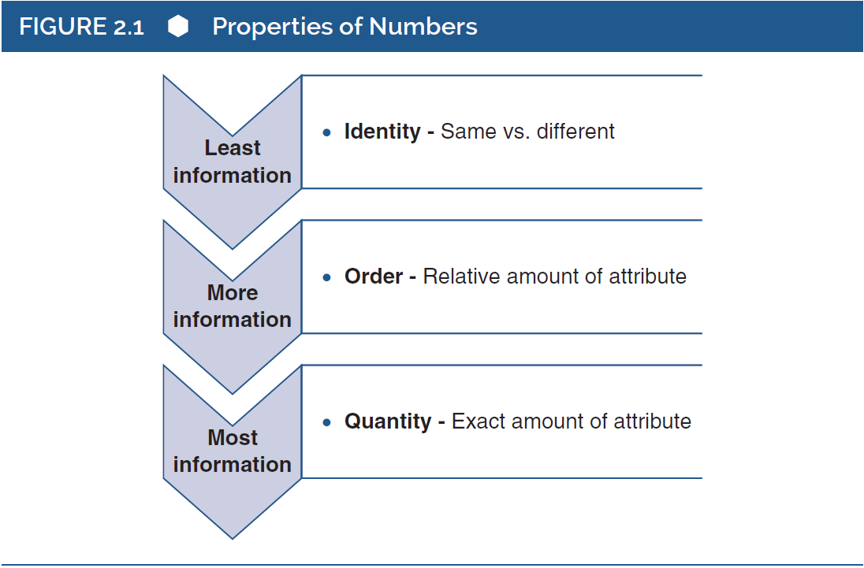
Properties of Numbers
Notes:
Figure 2.1: Properties of numbers.
This figure outlines the three numerical properties.
It also showcases the meaning of zero, which is a complex number and can have significantly different meanings in different contexts.

Slide 4
Fundamental Issues with Numbers (1 of 6)
Orientation toward numbers.
  Attributes are quantified by assigning a numerical value
Three numerical properties:
  Identity
  Order
  Quantity
Notes:
Orientation toward numbers:
In psychological measurement, a psychological attribute is quantified by assigning a numerical score to it.
Clearly, psychological measurement is heavily oriented toward numbers and quantification.
Different ways of numerical representation:
Numerals have important properties that can influence the way in which they are used to quantify a psychological attribute.
This implies that numerals can be used in multiple ways to represent a psychological attribute.
Three numerical properties:
There are three important numerical properties such as the property of identity, order, and quantity.
These properties reflect the different ways in which numeral can bring out the potential differences in psychological attributes.

Slide 5
Fundamental Issues with Numbers (2 of 6)
The Property of Identity
  Sameness versus differences.
    Categories (No numeric information here)
    Example: High vs. Low achieving students
    What’s missing?
  Rules of sorting:
    Categories must be mutually exclusive
    Categories must be exhaustive
Notes:
Sameness versus differences:
The presentation of “sameness versus differences” is the most basic form of measurement.
For instance, a teacher may be able to differentiate between two categories of students with the class—the well behaved and the “less” well behaved.
Placing objects or people into different categories implies that the members of the same category are similar to one another and are different from those in the other category.
In psychology, there is a minimum requirement of two categories and such categorization is done based on psychological attributes.
Rules of sorting:
To sort people into different categories, certain rules must be followed:
First, people within one category must satisfy the property of identity.
Second, the categories must be mutually exclusive.
Third, the categories must be exhaustive.
Holding the property of identity only:
When numerals only have the property of identity, they simply represent sameness versus differentness.
The numerals would be considered as having no true mathematical value.
Need for additional properties:
While placing people into different categories, the distinction between categories lies in the differences in quality rather than in the quantity.
This maybe considered as an imprecise way of measuring or representing behavioral attributes.
For measurement to reflect more than the presence and absence of categorization, numerals need additional properties.

Slide 6
Fundamental Issues with Numbers (3 of 6)
The Property of Order
  Conveys relative information.
    Example: student ranking based test scores; placing in a race, etc..
  Numbers still used as labels
  Limitations?
    Only relative amount of difference between scores
    Actual degree of difference is not measured
Notes:
The property of order:
It conveys more information than property of identity.
It offers information about the relative amount of an attribute that people possess.
Therefore, when numerals have the property of order, they show the rank order of people relative to each other along some dimension.
Numerals serve as labels:
When a numeral has the property of order, then it serves essentially as a label.
For instance, people within a category can be assigned a numeral based on their relative standing within the group for a specific attribute.
Limitation of the property of order: Property of order is still limited, because it only talks about the relative amount of difference between two people rather than the actual degree of difference in that attribute.
Example: Student ranking based on interest in learning:
Property of order lets the teacher rank the students in a class based on their interest in learning.
In that case, student ranked as 1 has a greater interest in learning than the students ranked as 2, 3, 4, or so.
However, how much more is the student who is ranked as 1 more interested in learning than the other students remains unknown.
Therefore, it can be summed up that numerals with the property of order are still unable to clearly represent the psychological differences.

Slide 7
Fundamental Issues with Numbers (4 of 6)
The Property of Quantity
  Magnitude of differences between people.
  Real number: basic unit of measurement.
  Units of measurement: a standardized quantity.
  Indicate the amount of an attribute
Notes:
Property of quantity:
It offers more information than the property of order.
This property of the numeral provides information about the magnitude of differences between people.
Real number:
Real numbers are continuous and can be scalar, metric, cardinal, or sometimes just quantitative values.
Real numbers form the basic units of measurement and can be divided into infinitely small parts.
Units of measurement:
Consider the case of using a thermometer to check the temperature and presenting the value in terms of degrees.
Degrees is the unit of measurement in this case, which is a standardized quantity.
The size of a unit is determined by some convention.
Power of real numbers:
Real numbers are considered powerful because they can be used to indicate the amount of an attribute of a person or a thing.
Therefore, psychologists always assume that their test scores come with the property of quantity.

Slide 8
Fundamental Issues with Numbers (5 of 6)
What does a score of zero mean?
  Number 0 as the absolute zero?
  Reference to relative or arbitrary zero?
  Arbitrary 0 more common in psychological testing
    Impossible to have “zero” intelligence or “zero” social skills
    Z-scores (0 == mean)
Notes:
Number 0 as the absolute zero:
The first possible meaning refers to a state where an attribute of an object or event has no existence.
In this case, the number 0 is called absolute zero.
Reference to relative or arbitrary zero:
The second possible meaning refers to an arbitrary quantity of an attribute and not the absence of anything.
For example: 0° on the Celsius scale.
In this case, the zero is referred to as a relative or arbitrary zero.
Common occurrence of arbitrary 0:
In psychological tests, the resulting zero is often the arbitrary zero rather than the absolute zero.
For instance, it is not possible for a conscious person to have zero intelligence or social skills.
Psychologists also use the z score to express test scores and the mean of distribution of z scores will always zero.
Issue in determining the meaning of a 0:
Problem may arise while determining if a test score of 0 should be relative or absolute.
Such a problem stems from the distinction between the features of the test and the features of the psychological attribute.

Slide 9
Fundamental Issues with Numbers (6 of 6)
Four elements for understanding scores:
  The three properties of numbers + How we interpret zero
Psychological tests usually deal w/ quantity
Notes:
An illustration of the problem.
Consider a case in which a sixth-grade student is given a spelling test.
If the student is unable to spell any of the words and ends up scoring a 0, does it imply that the student has a zero spelling ability?
In this case, the question arises about how the test score will be treated and if the zero should be treated as an absolute zero or a relative zero.
Significance of the type of the zero: Determining the type of zero is important for two reasons—interpretation and use of the test scores and determination of the types of analyses that can be conducted with the test scores.
Understanding the psychological scores:
To help shape the understanding of the psychological scores, there are four main elements needed.
This includes the three properties of numerals and the meaning of zero.
Generally, psychological tests are assumed to provide numerical scores that possess the property of quantity.

Slide 10
Units of Measurement (1 of 3)
Quantitative methods: Measuring by counting
  Obvious w/ physical measurement.
What about psychological characteristics?
  Less obvious (can’t be physically seen!)
  Measurements are responses recorded by the participant
    Questionable whether attribute is truly being measured
Notes:
Familiar in physical measurement:
Quantitative measurement demands the counting of the units of measurement.
In physical measurement, the units of measurement are familiar.
However, the same cannot be said about the units of measurement in psychological measurement.
Measuring psychological characteristics:
While measuring psychological characteristics like intelligence or memory, we will be dealing with less obvious units of measurements.
Mostly, they are the responses recorded by the participants and this raises the question about the relation between the responses and the psychological attributes that are about to be measured.
Arbitrariness:
The concept of arbitrariness is important for understanding units of measurement.
It helps to distinguish between different kinds of measurement units.

Slide 11
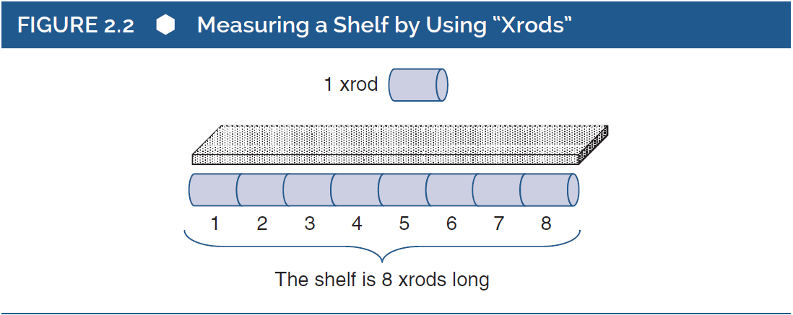
Units of Measurement (2 of 3)
Measurement units are arbitrary!
Unit size should not change!
Notes:
Figure 2.2: Measuring a shelf by using “xrods.”
To illustrate the notion of unit of measurement, consider the example of creating a unique measurement system “xrods” to measure wood and build a bookshelf.
It showcases the way the wood is cut to form xrods and how they can be used to determine the length of the shelf.
Xrods is now a unit of measurement and can be used to measure many things.

Slide 12
Units of Measurement (3 of 3)
Three ways measurement units can be arbitrary.
  Size
  Not always tied to a specific object
  Can measure multiple features of objects
    Example: Could measure weight with rulers
Standard measures: take all forms of arbitrariness in physical form.
Arbitrariness of psychological measures.
  Arbitrary in size only
Notes:
Ways in which measurement unit can be arbitrary:
Measurement unit can be arbitrary in three ways.
First, the unit size can be arbitrary.
Second, some units of measurement are not tied to anyone type of object and this is a form of arbitrariness.
The third form of arbitrariness is that some units of measurement can be used to measure different features of objects, when they take a physical form.
Xrods that can be used to measure length can also be used as a measure of weight.
This can be done by knowing the weight of a xrod and using them to replace the traditional weight on a balance scale.
Standard measures:
The units of measurement that can take all three forms of arbitrariness in their physical form.
Examples: Pounds, liters, and milliseconds are standard units in physical measurement.
Arbitrariness of psychological measures:
Psychological units of measurement are mostly arbitrary in size but are not covered by the other two ways of arbitrariness.
For example, IQ points which refers to the IQ test scores cannot be used as a reference beyond the tests for intelligence.

Slide 13
Additivity and Counting (1 of 4)
Counting in the xrod example.
  Length == total number
Counting in behavioral sampling.
  Certain units are counted to obtain a measurement scores (example: correct responses)
Notes:
The need for counting: Counting is an important part of physical as well as psychological measurements.
Counting in the xrod example:
When xrods were used to measure the length of the shelf, the xrods were placed end to end and “counted.”
This is an example of counting in the psychical world of measurements.
Counting in behavioral sampling:
Counting in behavioral tests can involve the counting of responses.
In other words, certain units are counted to obtain a score for the measurement.

Slide 14
Additivity and Counting (2 of 4)
Additivity: Unit size is always constant (scale is the same)
Key assumption in counting.
  Example of xrods (each xrod is the same length)
  What happens if the length changes?
Notes:
Key assumption in counting:
The concept of counting in measurement is based on the assumption that the unit size does not change and is always constant.
This may however not be valid in the case of psychological measurements.
The example of xrods:
While using xrods to measure length, each xrod was of the exact same length.
This made the process easy in terms of counting and arriving at an accurate answer.
However, the same cannot be said, if the xrods were of varying length.
Clearly, when the unit size of measurement (which is xrod in this case) is not constant, accuracy is lost.
Changes in conditions of measurement:
When the conditions of measurement change, the size of the measurement unit must continue to remain constant.
Ideally, there must be only one attribute of the thing that is being measured that can affect the measure.
This condition is called conjoint measurement.
Counting in psychological world:
An example can be used to show case how counting works in the psychological world.
A history test to measure the student’s knowledge of American history is conducted.
The right responses to the questions asked in the test are combined in some way and a total score that is interpreted as a measure of true knowledge of American history is generated.
In this case, each item represents the measurement unit which is used to obtain the test scores.

Slide 15
Additivity and Counting (3 of 4)
Counting in psychological world?
Example: Test to measure knowledge of American history
  Correct responses are combined in some way to generate a measure of true knowledge of American history
  In this case, each item represents the measurement unit which is used to obtain the test scores
Notes:
Key assumption in counting:
The concept of counting in measurement is based on the assumption that the unit size does not change and is always constant.
This may however not be valid in the case of psychological measurements.
The example of xrods:
While using xrods to measure length, each xrod was of the exact same length.
This made the process easy in terms of counting and arriving at an accurate answer.
However, the same cannot be said, if the xrods were of varying length.
Clearly, when the unit size of measurement (which is xrod in this case) is not constant, accuracy is lost.
Changes in conditions of measurement:
When the conditions of measurement change, the size of the measurement unit must continue to remain constant.
Ideally, there must be only one attribute of the thing that is being measured that can affect the measure.
This condition is called conjoint measurement.
Counting in psychological world:
An example can be used to show case how counting works in the psychological world.
A history test to measure the student’s knowledge of American history is conducted.
The right responses to the questions asked in the test are combined in some way and a total score that is interpreted as a measure of true knowledge of American history is generated.
In this case, each item represents the measurement unit which is used to obtain the test scores.

Slide 16

Additivity and Counting (4 of 4)
Psychological units.
  Amount of knowledge needed to answer each question differs
Measurement and psychological units don’t align perfectly
  Knowledge isn’t stored in equal sized units, so equal sized measurements can’t perfectly capture it!
Paradox in translating psychological attribute.
  How much of a psychological attribute does someone actually possess?
  Any number derived from a measurement unit can only approximate!
Notes:
Use of psychological units:
Alternatively, if psychological units were used instead of measurement units, the test score obtained may differ.
This is done by considering that the amount of knowledge needed to answer different questions is different.
While the measurement units will correspond closely with psychological units in most cases, there occurs a difference in scores.
Reason behind the discrepancy:
There occurs a difference in scores because the measurement units are not constant in terms of the underlying attribute that they are intended to reflect.
Since it is quite clear that knowledge cannot be in equal-sized units, the additive count of correct answers is not a good measure of amount of actual knowledge.
However, while using psychological units, the assumption that knowledge which is a psychological attribute exists in some amount.
Thus, a direct line cannot be drawn between the count of questions and the actual knowledge about American history.
Paradox in translating psychological attribute:
The amount of psychological attribute cannot, however, be translated into a set of numbers to measure the attribute.
This is because one does not know how much of the attribute actually exists.

Slide 17
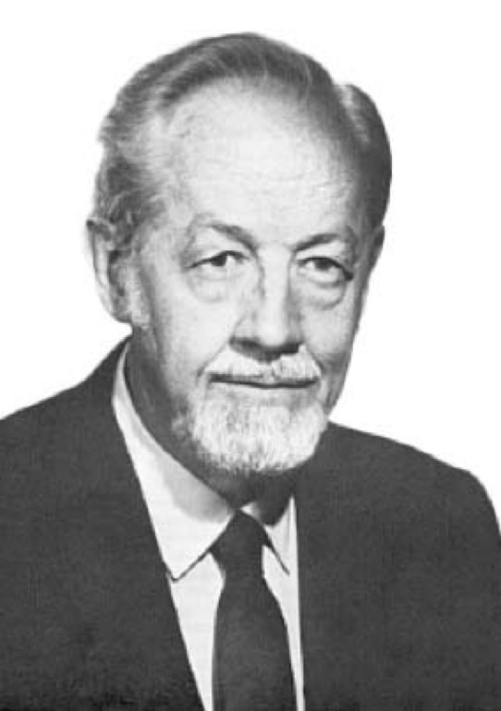
Four Scales of Measurement
(1 of 7)
Scaling: linking of numbers to behavioral observations.
Stanley Stevens (1946): Four levels of measurement.
  Most popular framework
Notes:
Scaling: Refers to the way in which numbers are linked to behavioral observations to create a measure.
Controversial nature of the definition:
The definition of scaling is controversial and continues to be so.
Some experts believe scaling is defined liberally and restrict scaling to the assignment of numbers that, at a minimum, have the property of order.
Other opt an even more restrictive definition that requires the use of scalars.
Four levels of measurement: Stevens has identified four levels of measurement in a popular framework: nominal, ordinal, interval, and ratio.

Slide 18
Four Scales of Measurement
(2 of 7)
Nominal Scales
Use of numbers with property of identity to label observations.
Example: sorting of children in classroom.
  Distinguishing the labels.
  Clear understanding of the scales.
Notes:
Nominal scale:
Nominal scale of measurement is the most fundamental level of measurement.
In this scale, the numbers with the property of identity are used to label observations in which behaviours have been sorted into categories according to some psychological attribute.
Example: sorting of children in classroom:
A classroom of children can be sorted into two groups: Group 1 with children have behavioral problems and Group 2 identifies with children without behavioral problems.
Our concern here would be to ensure that both groups are exhaustive and mutually exclusive.
Distinguishing the labels:
Nominal scale labels must be distinguished from labels used to identify or name individuals.
Nominal scale labels indicate groups with common attributes while label used to identify individuals (example: social security numbers) do not attempt to establish a group.
Clear understanding of the scales:
While using numerals to identify individuals, one must clear about the purpose of doing so.
In other words, the use of numerals to identify group membership or to essentially serve as names for individuals must be made clear.

Slide 19
Four Scales of Measurement
(3 of 7)
Ordinal Scales
Possessing the property of order.
Indicating the relative position.
Level of information conveyed.
Notes:
Possessing the property of order:
The ordinal scale of measurement involves using numerals that have the property of order.
In other words, this scale ranks people according to the level of attribute they possess.
Example: Athletes of a team can be ranked rank 1, rank 2, and so on based on their athleticism.
Indicating the relative position:
The ordinal scale indicates the relative position of an individual in a group based on the degree to which the individual possess a psychological attribute.
Nevertheless, there is no mention on how much of that psychological attribute is possessed by the individuals.
Level of information conveyed:
Ordinal scale of measurement offers most information than the nominal scale.
However, it has its limitations too.
Two different groups of individuals, ranked within their own but on the same psychological attribute cannot be compared.
For example: Individual with Rank 1 from one group may not possess the same extent of the attribute as the Rank 1 individual of the other group.

Slide 20
Four Scales of Measurement
(4 of 7)
Interval Scales
Characterized by property of quantity.
Arbitrary zero in interval scales.
Multiplicative interpretations are not allowed.
Tests that yield interval-level scores:
  IQ tests, personality tests, academic achievement tests (SAT, ACT, etc.)
Notes:
Interval scales:
Both interval and ratio scale of measured are characterized by the property of quantity.
The difference between them arises primarily from the meaning of zero.
Arbitrary zero in interval scales:
Interval scales have an arbitrary zero, that is, the zero does not represent the absence of any attribute.
Example: Temperature expressed in Celsius.
Multiplicative interpretations are not allowed:
In the interval scale of measurement, the size of the units are constant and additive.
However, multiplicative interpretations are not possible.
For instance, the amount of heat needed to change temperature from 40 to 42°C is the same as that needed to change from 80 to 82°C. But it would be incorrect to say that 80°C as having “twice as much heat” or being “twice as warm” as 40°C.
Tests that yield interval-level scores:
Several tests like intelligence tests, personality tests, achievement tests, and so on are measured using the interval scales.
However, experts suggest that only a very few tests are truly said to yield interval-level scores. Example: the academic assessment test, SAT.

Slide 21
Four Scales of Measurement
(5 of 7)
Ratio Scales
Have absolute zero point.
  Examples: Distance, Height, Weight, etc.
Issue in interpretation of differences.
  Multiplicative!
  May be impossible for someone to respond w/ zero
Understanding absolute zero point.
  Is zero a lack of response or a lack of the attribute?
Notes:
Ratio scale:
Interval scales come with an arbitrary 0 while ratio scales come with an absolute 0 point.
The zero in absolute scale can indicate the absence of attribute that is being measured. Example: distance.
Level of information:
Ratio scales allow more information and more sophisticated inferences that the other three scales.
This includes additivity as well as multiplicative interpretations.
Issue in interpretation of differences:
The fact that additivity and multiplicative interpretations are allowed in ratio scales gives rise to the issue of interpretation.
This issue arises between applied settings and research settings.
While it may come as a surprise, some researchers believe that no test can yield ratio-level data in psychology.
Understanding absolute zero point:
As mentioned earlier, absolute zero is a possibility in ratio scales.
However, it may be impossible for a person to respond to anything in 0 s.
The point to be noted here is that test users must distinguish between the zero associated with a measuring device and the zero associated with characteristics of the psychological attribute that we are measuring.

Slide 22
Four Scales of Measurement
(6 of 7)
Scales of Measurement: Practical Implications
Meaningfulness of certain descriptive statistics
  Example: An average isn’t meaningful for nominal data!
Tests and measures are assumed to be interval in nature
  Good for aggregate data from multiple scales, more difficult with single items/scales
Notes:
Meaningfulness of certain descriptive statistics:
Scale of measurement can have implications on the meaningfulness of certain descriptive statistics, such as a mean or correlation.
For instance, consider a nominal variable such as hair color.
While the mean of scores on a nominal variable can be calculated, finding out the average color makes no sense.
Also, the mean in this context would vary depending on arbitrary choices about the numbers we use to represent hair color.
Clearly, some specific descriptive statistical concepts do not turn into something meaningful when applied to scores based on certain scales of measurement.
Meaningfulness of parametric statistics:
The implications of scales of measurement on the use of parametric statistics is unclear.
Some experts suggest that parametric statistical procedures are appropriate only for interval or ratio scales, while a few other reject it.
As a result, the issue continues to remain controversial.
Interval level of measurement in tests and measures:
Behavioral researchers keep aside all disagreements and controversies and treat tests and measures as having an interval level of measurement.
This assumption plays well for aggregated scores obtained from multi-item scales but become tenuous for brief or single-item scales.

Slide 23
Four Scales of Measurement
(7 of 7)
Additional levels of measurement?
  Mosteller & Tukey: Six levels
Significance of Steven’s framework.
  Most commonly used!
Handling of dichotomous variables.
  Is binary data nominal or interval?
Notes:
Additional levels of measurement:
Apart from the Steven’s framework, there are other additional levels of measurement proposed by different authors.
For example, Mosteller and Tukey present a set of six types of scales, Michell believes that only interval-level and ratio-level scales count as measurements.
In fact, counting is a level of measurement and when used with psychological attributes, it becomes a measure with an absolute zero and a fixed nonarbitrary unit of measurement.
Significance of Steven’s framework: It has been chosen as the focus of our discussion because it is the most common choice and acts as a reasonable foundation for understanding the key issues as related to psychometrics.
Handling of dichotomous variables:
It is a general belief that frameworks are only used to represent nominal scales.
But dichotomous variables with binary codes can be thought of as producing interval-level data.

Slide 24
Common Measurement Scales in Psychology
Binary: Yes-No / Agree-Disagree / etc. (two response options)
Likert Scale: Multiple Response options (ordinal), 1-5 scale, etc.
Continuous responses: 0-100 percentage scales (ratio – zero indicates absence)

